Slide 1
Mwamba Ally Jingu: FCPA; PhD
Business Risk, Auditors Engagements Risk, Financial Reporting Risk and Audit Risk

Slide 2
Distinction between (i) Business Failure, (ii) Business Risk (iii) Audit Failure and (iv) Audit Risk
Several accounting and legal professionals believe that a main cause of litigation against audit firms is financial statement users’ lack of understanding of the Four concepts:
(i) Business Failure,
(ii) Business Risk
(iii) Audit Failure
and (iv) Audit Risk

Slide 3
Business Failure
A business failure occurs when a business ceases to operate because it is not able to cover its expenses or pay its liabilities.
Businesses can fail as a result of :
economic conditions, such as a recession
poor management decisions
or inability to compete with other similar businesses.
high taxation, high interest rates, or
a lack of public interest on the businesses’ products

Slide 4
Business Risk
ISA 315 (Revised) 2019 defines Business risk as a risk resulting from significant
(i) conditions,
(ii) events,
(iii) circumstances,
(iv) actions or
(v) inactions that could adversely affect an entity’s ability to achieve its objectives and execute its strategies, or from the setting of inappropriate objectives and strategies.

Slide 5
Audit Risk
In the context of financial statements audit, an audit failure occurs when an auditor issues an incorrect audit opinion because the auditor did not comply with the requirements of auditing standards.
For example, the auditor may express an opinion that the financial statements reflect a true and fair view while, in fact, they do not reflect a true and fair view.
It should be noted however, that audit failure does not necessarily mean that the audited financial statements are misstated. Rather, it just means that the auditor did not do enough work know whether or not they contain material misstatements or not.

Slide 6
Audit risk
Audit risk represents the possibility that the auditor conducts an audit according to auditing standards but expresses an incorrect audit opinion that the financial statements shows a true and fair view while, in fact, they do not show a true and fair.
Auditing standards give a strict definition on an audit risk in that the auditor incorrectly issues an unmodified audit opinion and not incorrectly issues a modified opinion.
Thus, if an auditor expresses an opinion that the financial statement reflects a true and fair view while, in fact they do reflect a true and fair view the opinion is still incorrect but that does not amount to an audit risk.

Slide 7
Audit Risk continued
Audit risk cannot be avoided because auditors collect audit evidence only on a test basis and since well-concealed frauds are very difficult to detect.
An auditor may fully comply with auditing standards and still fail to uncover a material misstatement .
When an audit fails to uncover material misstatements and an incorrect audit opinion is issued, it is appropriate to question whether the auditor exercised due care in performing the audit.
In case of audit failure, the law often allows parties who suffered losses to recover some or all of the losses caused by the audit failure.

Slide 8
Audit Risk continued
Difficulties often arise when business failure, and not audit failure occurs.
Thus, when a company files for bankruptcy, users of financial statements commonly claim that, an audit failures has occurred, especially when the most recent issued audit report indicates that the financial statements were fairly stated.
Even worse, if a business failure happens and the financial statements are later determined to have been misstated, users may claim the auditor was negligent even if the audit was conducted in accordance with auditing standards.

Slide 9
Business Risk, Auditors’ Engagements and Audit Risk
The four critical components of risk that will affect the audit approach are:
Enterprise risks. These are risks that affect the operations of the business
Engagement risks are the auditors encounter by being associated with a particular client. They include exposure to financial loss, or damage to his/her professional reputation from litigation, adverse publicity, or other events arising in connection with financial statements audited and reported on.
Financial reporting risks are risks that relate directly to the recording of transactions and the presentation of financial data in an entity’s financial statements
Audit risk is the risk that the auditor may provide an unmodified opinion on the financial statements that are materially misstated

Slide 10
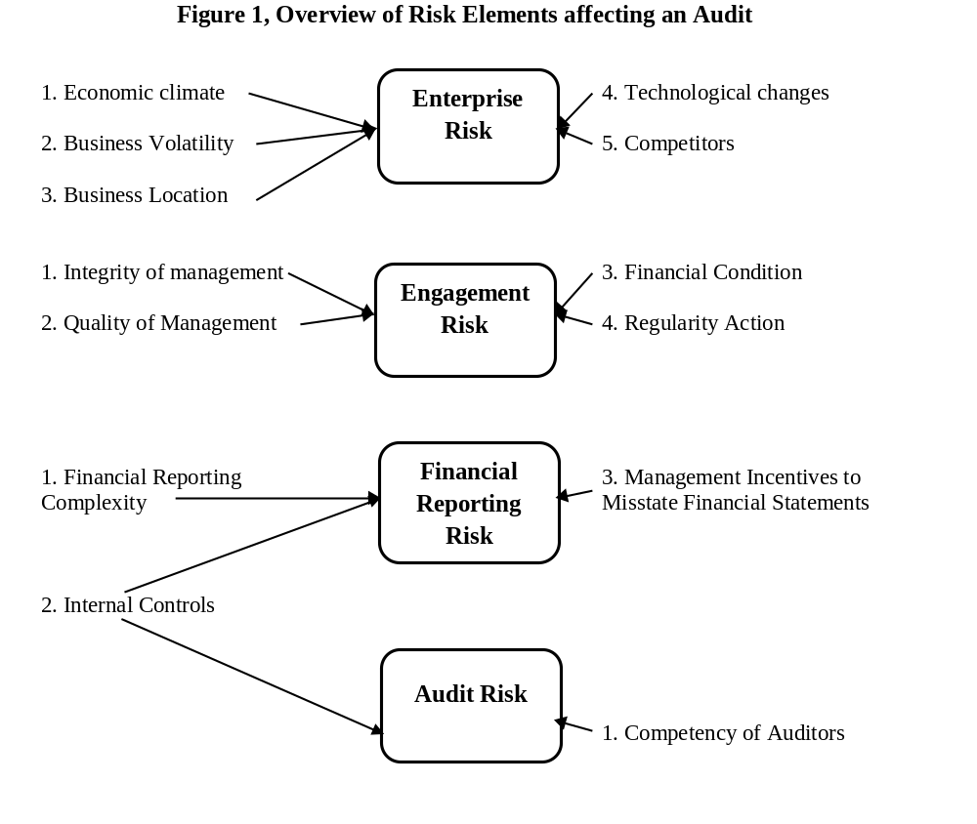

Slide 11
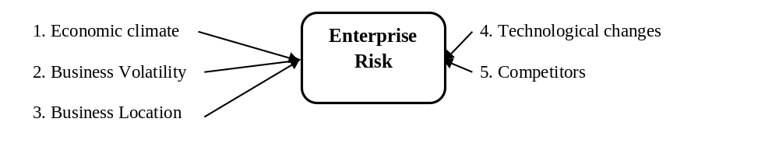
Enterprise (Business) Risk
Factors that affect business risk include
Economic climate: An improvement in economic conditions would lead investors to be more optimistic about the future and potentially invest more as they expect positive returns. Also the economy affects buying power
Business Volatility: Volatility is the pace at which prices move higher or lower, and how wildly they swing. This depends on wild swings in demand and supply
Business Location: Location is the place where an organization operates its business. Location decisions can have a big impact on costs and revenues.
Technological changes: This is an increase in the efficiency of a product or process that results in an increase in output, without an increase in input.
Competitors: Any person or entity which is a rival against another. The presence of one or more competitors can reduce the prices of goods and services as the companies attempt to gain a larger market share.

Slide 12
Economic Risk
The economic climate may have a big impact on businesses.
The level of consumer spending affects prices, investment decisions and the number of workers that businesses employ.
The economic climate may affect businesses in six main ways:
unemployment
changing levels of consumer income
changes in interest rates
inflation
government taxation
changes in exchange rates

Slide 13
Business Volatility
Volatility is the pace at which prices move higher or lower, and how wildly they swing. These can be prices of just about anything.
Price volatility is caused by three factors that produce wild swings in demand and supply. The first is seasonality.
For example, all types of meat prices rise during Christmas Ramadhan, when people their demand is high. They drop after these periods. That is an example of changes in demand.
Another factor affecting price volatility is the weather. For example, agricultural prices depend on the supply.
A third factor is emotions. When traders worry, they aggravate the volatility of whatever they are buying. That's why the prices of commodities are so turbulent

Slide 14
Business Location
Geographical location is also a potential risk for enterprises for a number of reasons such as:
crimes threats,
availability of reliable security,
high competitions: Are competing companies close by
availably of reliable customers and how close they are to the business location
Foot Traffic: foot traffic is very important. Nobody wants to be tucked away in a corner where potential customers will pass him/her by.
Parking and Accessibility: If you are on a busy street, is it easy for cars to get in and out of your parking lot

Slide 15

Technological changes
Technological changes represent a high risk for a company where technology develops at an amazingly fast speed such as a telephone trading company
This is because the devices produced yesterday become out-of-date very fast and loose market
History indicates that devices that
have only one use like calculators,
alarm clocks and cameras were good
yesterday but today they are being
replaced by smartphones.
Phone chargers, and with cords are
also fading out in favor of wireless
models. There is a chance that remote charging may soon become a reality

Slide 16
Technological changes Continued
While we are not sure what idly innovative ideas the future will bring, but there is a pretty good sense of which devices will fall into to disuse.
few things that will probably be obsolete by 2030 include:
Gold rings and gold chains because the yellow metal is slowly disappearing from earth's surface
By 2035 there won’t be any privacy because wherever you are, wherever you go, with the advancement of the Internet of Things (IoT) technology you will always be under watch.
By 2040 Fast-Food workers will also be looking for a job change because Taking orders, preparing meals, and serving guests are jobs that will be handled by robots while touch screens will be installed for selecting items from the menu, your meal will be assembled by the bots themselves

Slide 17
competitions.
Business Competition is the contest among businesses selling similar products and targeting the same buyers to gain more market share compared to others.
In a global market, businesses face a number of competitions.
Competitors will try to win market share by cutting costs, improving efficiency, lowering price and innovating by either creating new products /services or improving upon old ones.
Increased competition can create lower market share and fewer profits for any company. It makes a business overspend on marketing and other promotional strategies to persuade the customers, and business partners..
“Without a robust and resilient innovation strategy, no company can survive”

Slide 18
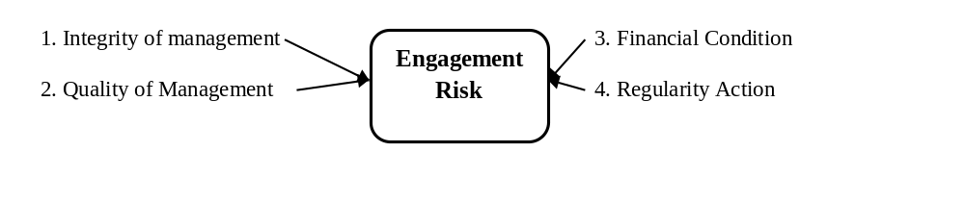
Engagement Risk
Engagement risk has been defined as the risk (resulting in a potential loss) that the auditor might incur by being associated with a particular client.
Engagement risk is influenced by:
The Management integrity: Specifically, management with questionable integrity increases the engagement risk.
quality of management. Specifically, incompetent or/and lazy management increases the engagement risk.
Financial condition of the company. For example, if a company is on the brink of declaring bankruptcy, it is more likely that the auditor’s opinion will be questioned

Slide 19
Engagement Risk Continued
If the auditor questions management integrity, then the auditor cannot trust management responses to audit questions and there is a possibility that management will hide financial misstatements.
Auditors have discovered that being associated with companies with poor` integrity creates risks that can destroy the auditor or significantly increase costs.
For example, PWC has run into trouble with its regulator several times in recent years: In 2018, it was fined £6.5m (TZS 19,500,000,000) and in 2017, it was fined £5.1m
The regulator also fined said it fined KPMG £455,000 ($564,225), and Nicola Quayle, a former senior partner in its Manchester office, £29,250.

Slide 20
Auditors Responses to Engagement Risks
The auditor reacts to high engagement risks by:
Not associating with high risk audit clients. That is referred to as the “client acceptance/retention decision, or
Setting audit risk low, that is, to manage the risk of materially misstated financial statements by increasing amount of audit work to render an audit opinion.
There are several factors that affect the auditor’s decisions to accept or retain an audit client.
but most factors revolve around management integrity, management competence, the company’s risk management process, corporate governance and the financial condition of a company

Slide 21
Financial Reporting Risk
Financial reporting is the process of reporting the profit or loss and the financial position of a reporting entity.
Financial data is the name given to the record of actual transactions carried out by a business e.g. sales of goods, purchases of goods, payment of expenses
The key factors that affect financial reporting risk include:
The quality of the company’s internal control
The complexity of the company’s transactions and financial reporting
Management’s motivation to misstate the financial statements
The company’s financial health

Slide 22
Accepting New Clients: Reducing Risks
Current auditing standards on “Audit Firm Changes” require a successor auditor to discuss with the predecessor auditor to gain an understanding of the reasons for the change.
Because of the confidentiality rule, the successor auditor must obtain the clients permission to talk to the predecessor auditor.
The auditor is particularly interested in determining whether there was any disagreement with the client on auditing or accounting procedures that would have led to the auditor’s dismissal or resignation.
Auditing standards requires the focus on the following: integrity of Management; disagreement with management on accounting or auditing

Slide 23
Questions
Q1: Engagement risk is the risk that auditors encounter by being associated with a particular client: which of the following would not be considered an engagement risk?
A: loss of reputation
B: inability of the client to pay the auditor
C: financial loss because management is not honest
D: Technological changes
Q2: Engagement risk means that it may be too risky for an auditor to be associated with a client because such association will likely have an adverse effect on the auditor. Engagement risk is influenced by several factors. Which of the following do not influence engagement risk?
A: the integrity and quality of management
B: The current financial position of the client
C: if the company is on the verge of declaring bankruptcy
D: Geographic location of the client

Slide 24
Questions
Q3: Engagement risk has been defined as a risk (resulting in a potential loss) that an auditor might incur by being associated with a particular client. Engagement risk is most likely not increased when an audit firm is associated with the following:
A: management with questionable integrity
B: a failed company, e.g., a company files for bankruptcy
C: a materially misstated financial statement
D: a company with strongly effective corporate governance
Q4: Audit firms understand that being associated with companies with poor integrity creates risk that can destroy the firms. Thus each year they take several measures to address the risky clients. Which of the following measures is not related to the avoidance of risky clients?
A: establish a client acceptance procedure (decide whether to accept a client)
B: establish a client retention procedure (decide whether to retain a client)
C: avoids all companies that have questionable management integrity
D: Choice “C” is the only right answer

Slide 25
Q5: The auditor responds to high engagement risks in one of the two ways. Which of the following responses is (are) true?
to effectively manage engagement risk by not associating with “high risk” audit client (“client acceptance or retention decision”)
by setting audit risk low, i.e., to manage the risk of materially misstated financial statements by increasing an amount of audit work
A: (i) only
B: (ii) only
C: (i) and (ii) and simultaneously
D: (i) or (ii) but separately

Slide 26
Question
Q6: In few cases, successor auditors need to communicate with the predecessor auditors. Several conditions should fulfilled before such communication to succeed. The conditions include.
The successor auditor should obtain the client’s permission before communicating with the predecessor (this is due to a professional ethic of confidentiality).
The successor auditor should ask the client to authorize the predecessor auditor to respond fully to inquiries (this is due to a professional ethic of confidentiality).
A; (i) only
B: (ii) only
C: (i) and (ii) simultaneously
D: (ii) or (ii) separately

Slide 27
Pick a pair that consist of all two correct statements, assuming that all other factors remain unchanged.
Q1 Relationship between Financial Reporting Risk and the amount of Audit Evidence
A (i) If the client’s financial reporting process is very complex then the financial reporting risk may be high (ii) If the financial reporting process of the client is very complex then the auditor should plan to collect less audit evidence
B (i) If the client’s financial reporting process is very complex then the financial reporting risk should be high (ii) If the financial reporting process of the client is very complex then the auditor should plan to collect more audit evidence
C (i) If the client’s financial reporting process is very complex then the financial reporting risk should be low (ii) If the financial reporting process of the client is very complex then the auditor should plan to collect more audit evidence
D (i) If the client’s financial reporting process is very complex then the financial reporting risk should be low (ii) If the financial reporting process of the client is very complex then the auditor should plan to collect less audit evidence

Slide 28
Pick a pair that consist of all two correct statements, assuming that all other factors remain unchanged
Q2 Relationship between Financial Reporting Risk and Audit Risk
A (i)If the client’s internal control process is strong and effective then the financial reporting risk should be low (ii) If the client’s internal control process is strong and effective then the auditor may set his or her audit risk high
B (i) If the client’s internal control process is strong and effective then the financial reporting risk should be high (ii) If the client’s internal control process is strong and effective then the auditor may set his or her audit risk high
C (i)If the client’s internal control process is strong and effective then the financial reporting risk should be low (ii) If the client’s internal control process is strong and effective then the auditor may set his or her audit risk low
D (i)If the client’s internal control process is strong and effective then the financial reporting risk should be high (ii) If the client’s internal control process is strong and effective then the auditor may set his or her audit risk low

Slide 29
Pick a pair that consist of all two correct statements, assuming that all other factors remain unchanged
Q3 Relationship between Auditor’s Engagement Risk and Audit Risk
A (i) If the integrity of the client’s management is high then the auditor’s engagement risk should be high (ii) If the integrity of the client’s management is high then the auditor should set his or her audit risk low
B (i) If the integrity of the client’s management is high then the auditor’s engagement risk should be low (ii) If the integrity of the client’s management is high then the auditor may set his or her audit risk low
C (i) If the integrity of the client’s management is high then the auditor’s engagement risk should be high (ii) If the integrity of the client’s management is high then the auditor may set his or her audit risk high
D (i) If the integrity of the client’s management is high then the auditor’s engagement risk should be low (ii) If the integrity of the client’s management is high then the auditor may set his or her audit risk high

Slide 30
Pick a pair that consist of all two correct statements, assuming that all other factors remain unchanged
Q4 Relationship between Auditor’s Engagement Risk and Detection Risk
A (i) If the client’s financial position is extremely weak then the auditor’s engagement risk should be low (ii) If the client’s financial position is extremely weak then the auditor should plan for a low detection risk
B (i) If the client’s financial position is extremely weak then the auditor’s engagement risk should be low (ii) If the client’s financial position is extremely weak then the auditor should plan for a high detection risk
C (i) If the client’s financial position is extremely weak then the auditor’s engagement risk should be high (ii) If the client’s financial position is extremely weak then the auditor should plan for a low detection risk
D (i) If the client’s financial position is extremely weak then the auditor’s engagement risk should be high (ii) If the client’s financial position is extremely weak then the auditor should plan for a high detection risk

Slide 31
Pick a pair that consist of all two correct statements, assuming that all other factors remain unchanged
Q5 A link between auditor’s engagement risk and the Risk of Material Misstatements
A (i) If the quality of the client’s management is high then the auditor’s engagement risk will be low (ii) If the quality of the client’s management is high then the risk of materials misstatements in the financial statements may be high
B (i) If the quality of the entity’s managers is high then the auditor’s engagement risk will be low (ii) If the quality of the entity’s managers is high then the risk of materials misstatements in the financial statements may be low
C (i) If the quality of the client’s management is high then the auditor’s risk of engagement may be high (ii) If the quality of the client’s management is high then the risk of materials misstatements in the financial statements may be high
D (i) If the quality of the client’s management is high then the auditor’s engagement risk will be high (ii) If the quality of the entity’s managers is high then the risk of materials misstatements in the financial statements may be low

Slide 32
Thank You

